Slide 1
Unpacking Unconscious Bias
Live Session

Slide 2


Moodle and WebEx

Slide 3
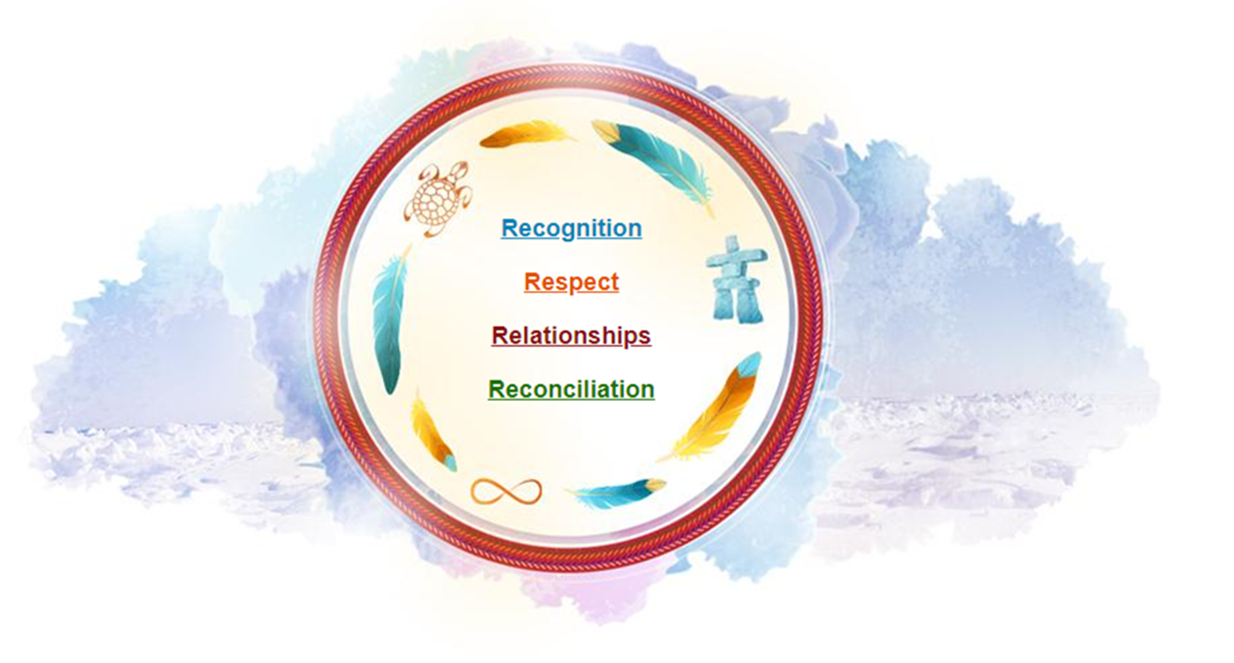
Territorial Acknowledgement

Slide 4
The Facilitating Team
Facilitator
Two Producers

Slide 5




Housekeeping
Virtual Learning Safety Measure
Feedback Personal Learning Journal

Slide 6
Course Learning Objectives
After completing this course, you will be able to:
understand what biases are and recognize the multiple forms of biases
be more aware of and think about the consequences of unconscious biases in the workplace for those involved, including yourself
understand and use tools, tips and strategies to better acknowledge and mitigate unconscious bias

Slide 7
Course Overview
Day 1: Introduction
Live Session
Welcome and introductions
Pre-reading debrief
Faces of diversity
Personal reflection exercises
Implicit attitude test
Micro-aggression video
Learning journal
Day 2: All About Biases
Live Session
Pre-reading debrief
Biases (what they are, where they come from, and who has them)
Workplace bias
Personal reflection exercises
Vocabulary activity
Learning journal
Day 3: Strategies and Tools to Mitigate Biases
Live Session
Discussion of points of view
Inclusive leader continuum
Strategies and tips to identify and manage unconscious bias
Personal reflection exercises
Facing your own biases
Video
Learning journal
Day 4: Reinforcing Your Learning
Live Session
Recognizing others’ biases
Systemic barriers
Moving from recognizing bias to mitigating bias
Questions and concluding remarks

Slide 8
Bias Training
Please answer the following question using the poll function.
Please select all the answers that apply.
How do you feel about taking training on biases?

Slide 9
Introductions
Your name
Your department
Your pronouns
Where you come from
Your personal learning goals and/or expectations for this course

Slide 10

Break
Let’s take a quick break.
Please return in 10 minutes.
Please post a green checkmark (✓) when you are back from your break. Thank you!

Slide 11
Break
Please return in 9 minutes.
Please post a green checkmark (✓) when you are back from your break. Thank you!

Slide 12
Break
Please return in 8 minutes.
Please post a green checkmark (✓) when you are back from your break. Thank you!

Slide 13
Break
Please return in 7 minutes.
Please post a green checkmark (✓) when you are back from your break. Thank you!

Slide 14
Break
Please return in 6 minutes.
Please post a green checkmark (✓) when you are back from your break. Thank you!

Slide 15
Break
Please return in 5 minutes.
Please post a green checkmark (✓) when you are back from your break. Thank you!

Slide 16
Break
Please return in 4 minutes.
Please post a green checkmark (✓) when you are back from your break. Thank you!

Slide 17
Break
Please return in 3 minutes.
Please post a green checkmark (✓) when you are back from your break. Thank you!

Slide 18
Break
Please return in 2 minutes.
Please post a green checkmark (✓) when you are back from your break. Thank you!

Slide 19
Break
Please return in 1 minute.
Please post a green checkmark (✓) when you are back from your break. Thank you!

Slide 20
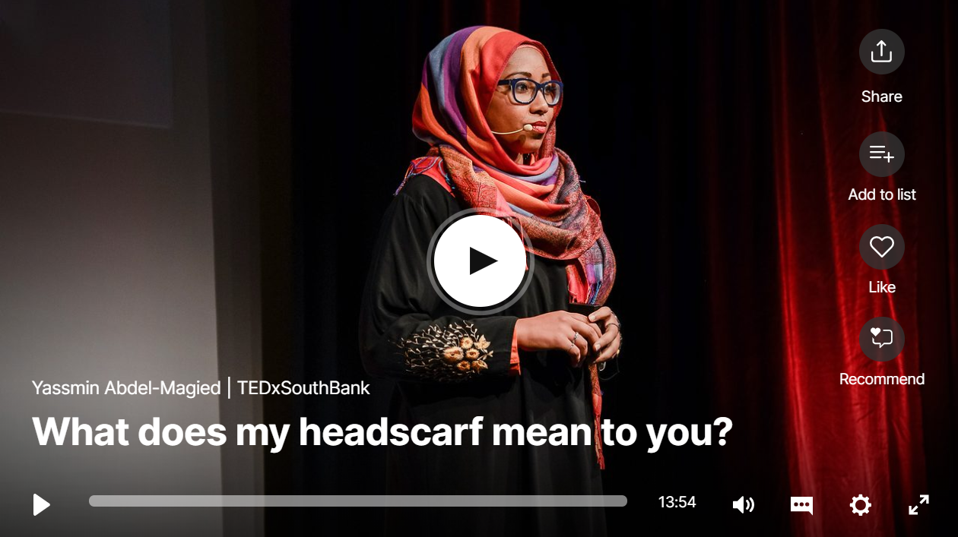
Pre-Reading Video Debrief

Slide 21
Faces of Diversity
Government of Canada Context

Slide 22
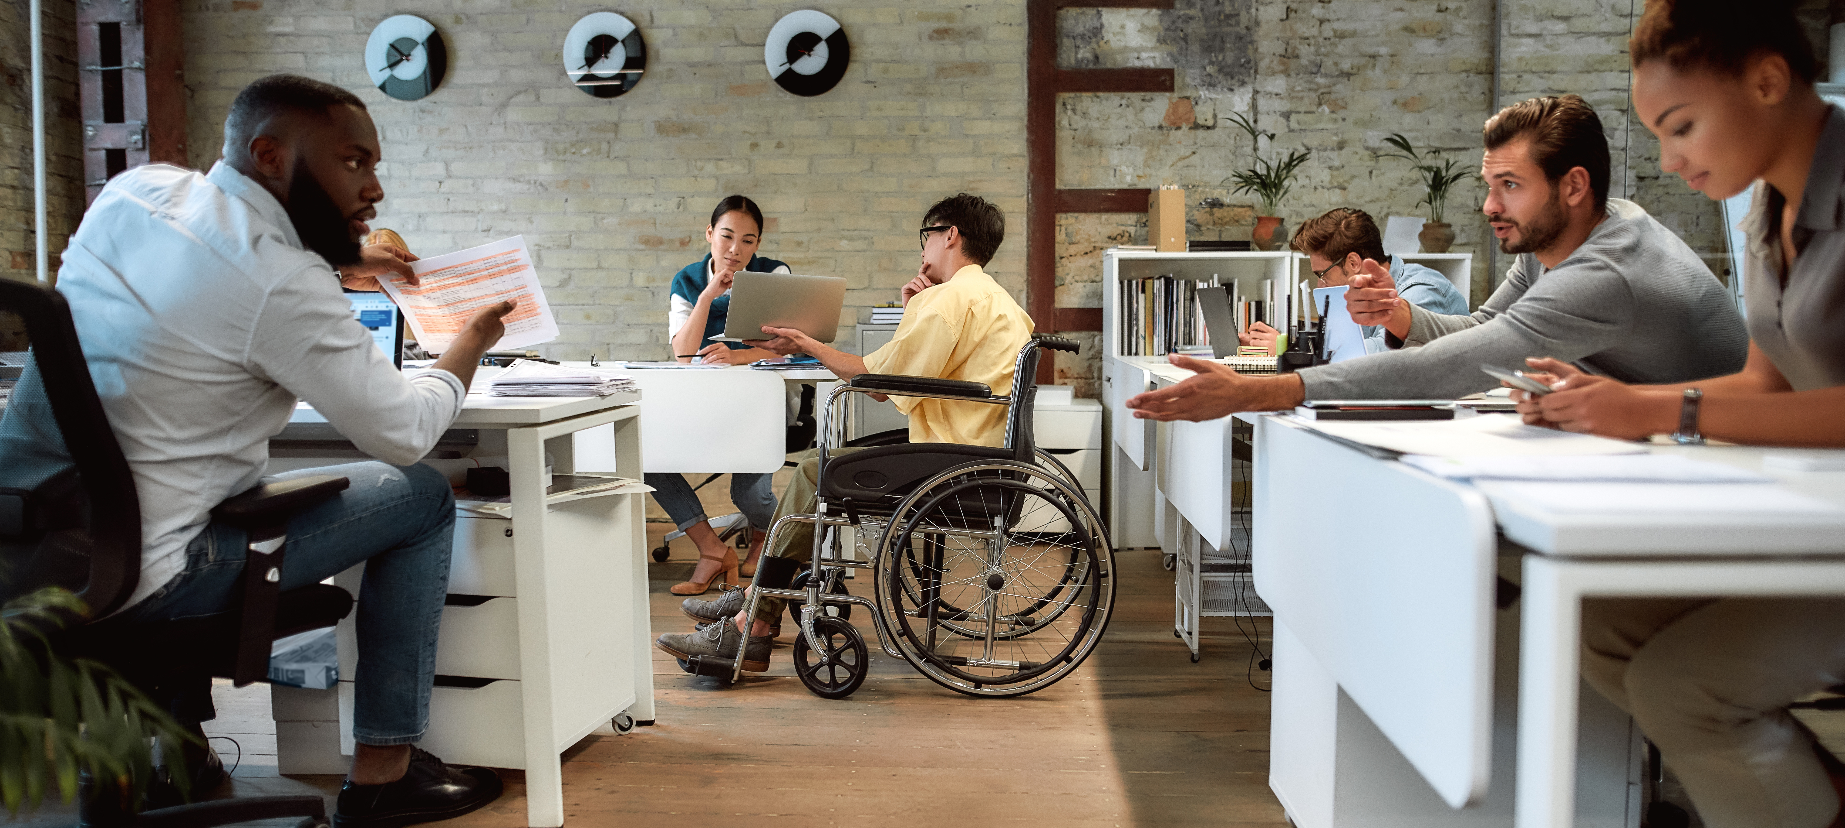
Our Context: The Government of Canada
Better understand and serve Canada’s diverse communities or internal and external clients
Be part of a diverse workforce: colleagues, employees, supervisors, managers, clients…
Be part of the public service, an inclusive employer of choice

Slide 23
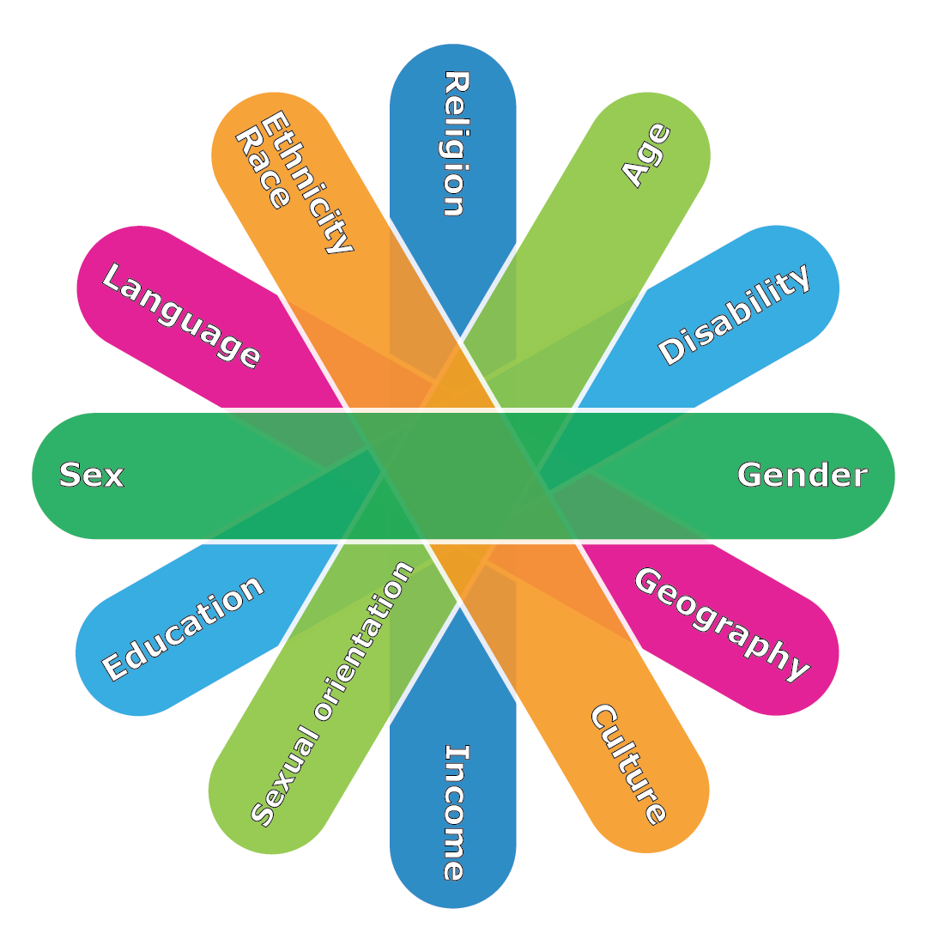
The Faces of Diversity

Slide 24
The Circle of Trust Activity Debrief

Slide 25
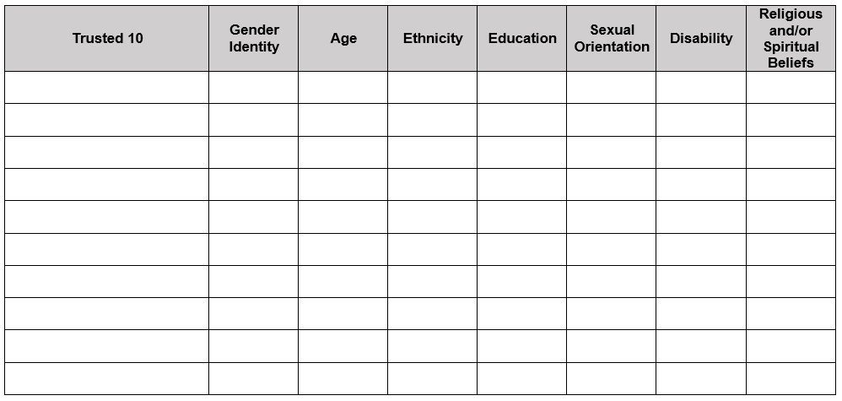
The Circle of Trust

Slide 26
Inclusion
Please answer the following question using the chat function.
What does inclusion mean to you?

Slide 27
Questions?

Slide 28
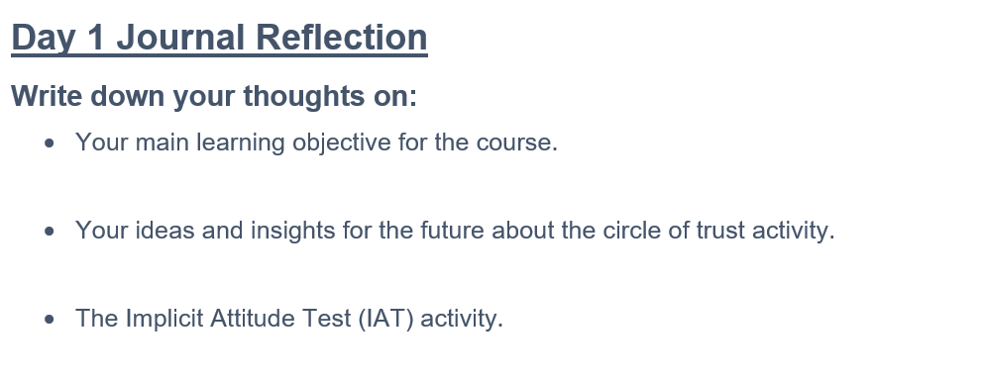
What to Prepare for Next Session
Implicit Attitude Test
Video on Micro-aggressions
Personal Learning Journal

